Slide 1

The Pastor
as Leader:
Servant Leadership for a Servant Community
E. LeBron Fairbanks,
Nazarene Theological College, Brisbane

Slide 2
Course Vision
The overarching vision for this course is for each student to embrace the biblical model of “servant” as the driving force and organizing principle within the individual as she/he seeks to lead a local congregation as a Christian community of faith.

Slide 3
Course Purpose
In the context of biblical and theological foundations, and from the perspectives of spiritual, strategic, and skills formation, this course will encourage each participate to a lifelong pursuit of and commitment to personal and congregational understanding of Christian leadership and the unique relationship between the theology we profess and the way we lead.

Slide 4
Course Themes
The MOTIVATION of servant leadership is grounded in a theology of church and ministry.
The LIFESTYLE of servant leadership is characterized by a passion for Christlikeness.
The GOAL of servant leadership is reconciliation, transformation, and disciple-making, individually and collectively.
The METHOD of servant leadership is example, visioning, “strengths-development,” and teaching.
The PAIN of servant leadership is experienced in the tension when good and Godly people collide.
The EVIDENCE of servant leadership is in the qualitative growth of the led.

Slide 5

Monday
Afternoon
Motivation of
Leadership

Slide 6
“The Servant leader is a servant first . . .
The best test, and difficult to administer, is: do those served grow as persons; do they, while being served, become healthier, wiser, freer, more autonomous, more likely themselves to become servants?
And, what is the effect on the least privileged in society;
Will they benefit, or at least not be further deprived?
Robert Greenleaf

Slide 7
“A Servant leader is one who is a servant first.”

Slide 8
Three Driving Forces . . .
a VISION of who we are as the people of God;
a PASSION for what we are called to do in the work of God: and
an OBSESSION for how we are to live together as a family of God.

Slide 9
Four priorities . . .
Spiritual leadership to the campus community – staff, faculty, senior administrators and students.
University-wide strategic thinking, planning, and leading;

Slide 10
Four priorities . . .
Christian leadership development – locally, regionally, and worldwide; and
Major donor cultivation/gifting and endowment development.

Slide 11
Three questions . . .
How can we live together as Christians in a diverse faith community so that our relationships are redemptive and a witness to unbelievers of the reconciling work of God in Christ?

Slide 12
Three questions . . .
If “in Christ, all things are made new.” then how does our relationship with Christ inform and transform the way we lead a Christian community?

Slide 13
Three questions . . .
In conflicting situations within the community of believers, when seemingly irreconcilable expectations are placed on the leaders from multiple constituency groups, how does one lead in these situations, really lead, with “the mind of Christ?”

Slide 14
Seven expressions of the servant leader:
The Ministry of Holding One’s Tongue.
The Ministry of Meekness.
The Ministry of Listening.
The Ministry of Active Helpfulness.
The Ministry of Bearing Another’s Burdens.
The Ministry of Proclaiming the Word of God.
The Ministry of Authority.
From Life Together – Dietrich Bonheoffer

Slide 15
Christian leadership is
humble service to others,
for the purpose of enabling them, through teaching and example,
to live their lives under the Lordship of Christ,
and to understand, accept, and fulfill their ministry to others and their mission to the world.
E. LeBron Fairbanks

Slide 16
How can my ministry of Christian leadership enable others to fulfill their ministry to others and their mission in the world in the context of a dynamic laboratory of learning how to live together as God’s children?

Slide 17
“Leadership is known by the personalities it enriches, not by those it dominates or captivates. Leadership is not a process of exploitation of others for extraneous ends… The proof of leading is in the qualitative growth of the led as individuals and as group members.”
Dr. Harold Reed

Slide 18
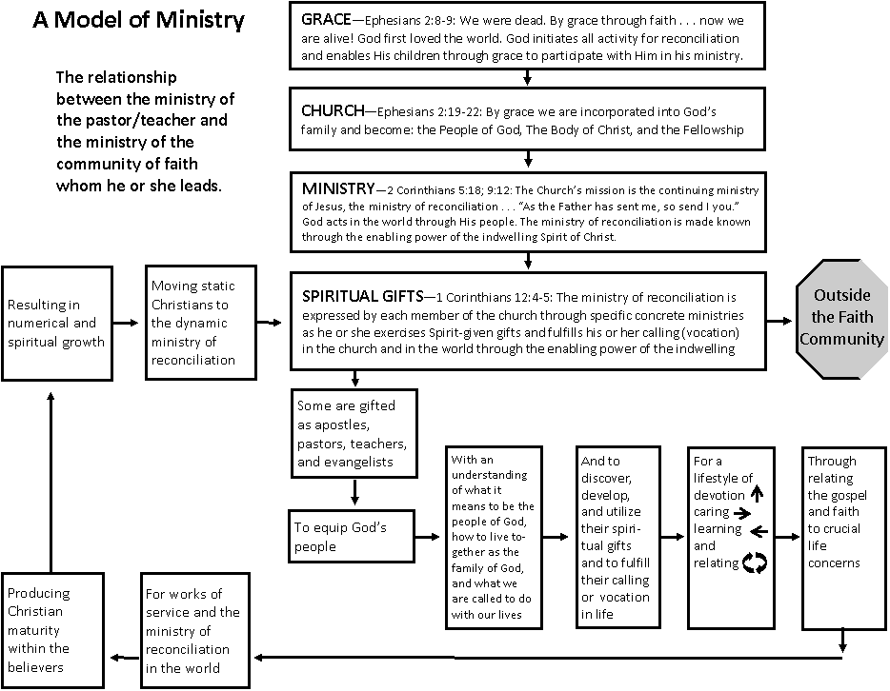

Slide 19
Tuesday
Morning
Lifestyle of
Leadership

Slide 20
A Christian Leadership Lifestyle:
Instructions:
Key Concept: Communication is the greatest single factor affecting one’s personal health and his/her relationship to God and others.
Key Question: How can we so live together as Christian that our relationships are redemptive and a witness to unbelievers of the reconciling work of God in Christ?
Key Challenge: “Living Worthy of our Calling” – Ephesians 4:1

Slide 21
A Christian Leadership Lifestyle:
Key Insight: “Living the Reconciled Life” – Ephesians 4:2-3.
Key Principle: “Speaking the Truth in Love” – Ephesians 4:15-16.
Key Application: Ephesians 4:25-32.

Slide 22
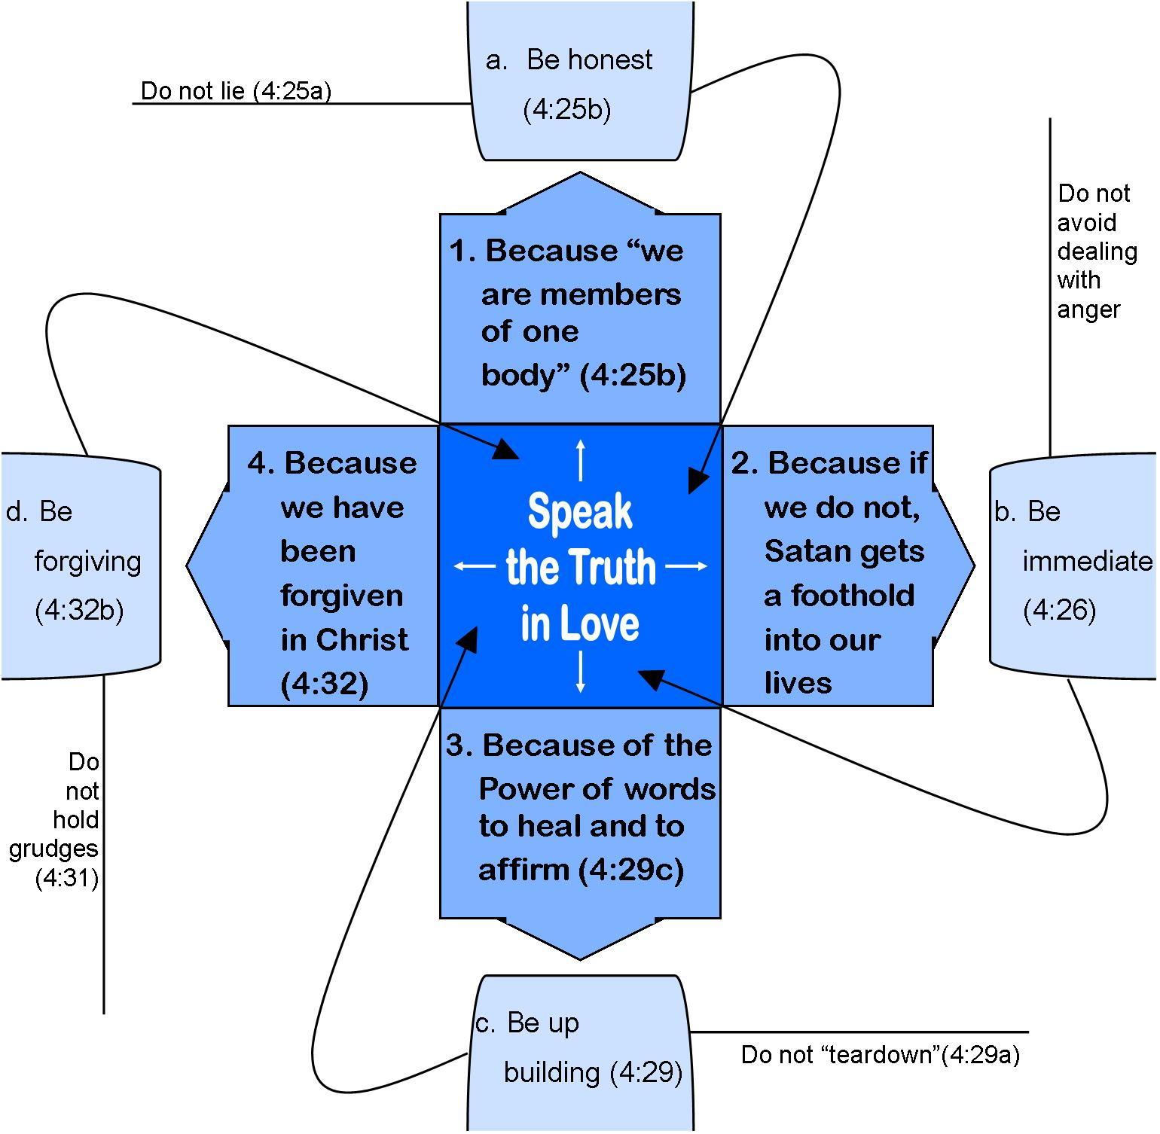
A Communication Model for Leading the People of God
Ephesians 4
4:26
(4:27)

Slide 23
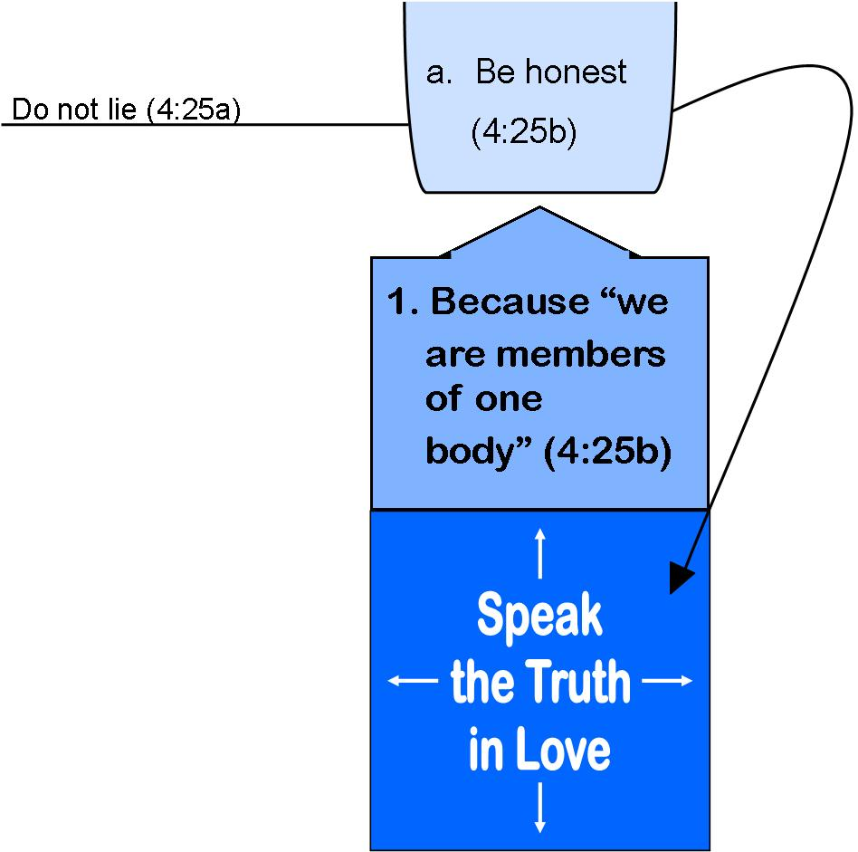
We “SPEAK THE TRUTH IN LOVE” because: WE ARE MEMBERS OF ONE BODY. Ephesians 4:25

Slide 24
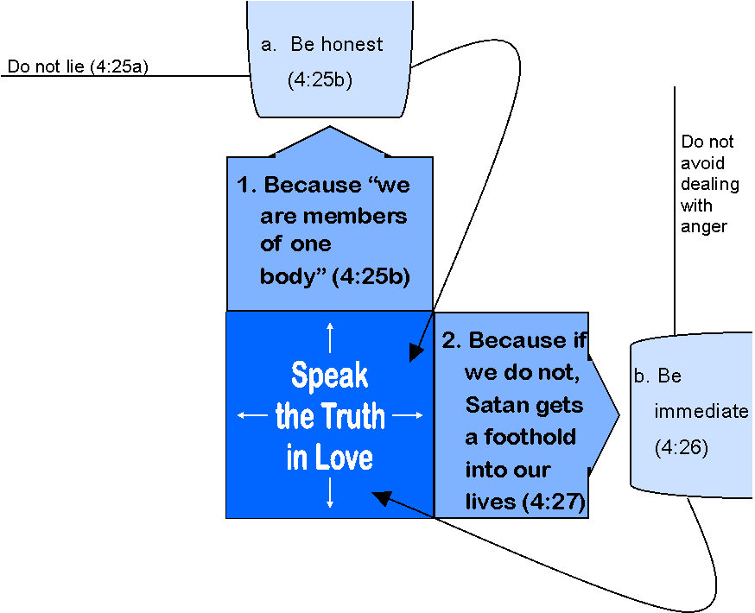
WE SPEAK THE TRUTH IN LOVE BECAUSE WHEN WE DO NOT, SATAN GETS A FOOTHOLD IN OUR LIVES (Ephesians 4:26-27)
4:26

Slide 25
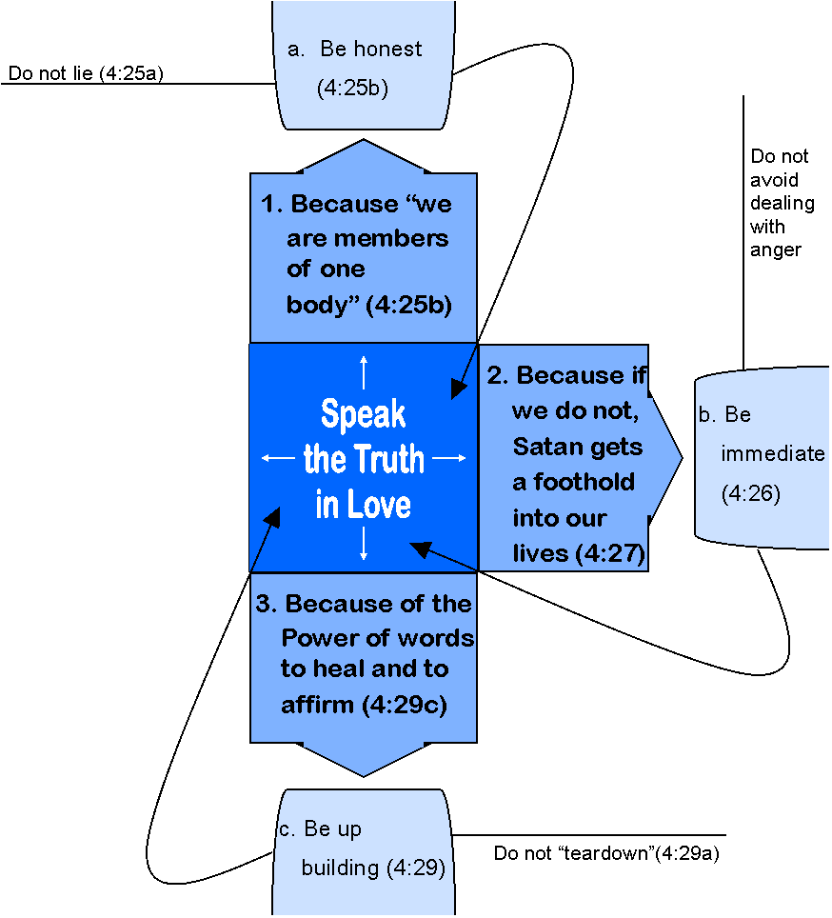
We “SPEAK THE TRUTH IN LOVE” because of the power of words to heal and to affirm. Ephesians 4:29c
4:26
Be
Up-building
(4:29)

Slide 26
WHY DO WE “SPEAK THE TRUTH IN LOVE?” BECAUSE WE HAVE BEEN FORGIVEN IN CHRIST. Ephesians 4:31-32)
4:26
(4:27)
Be
Up-building
(4:29)

Slide 27
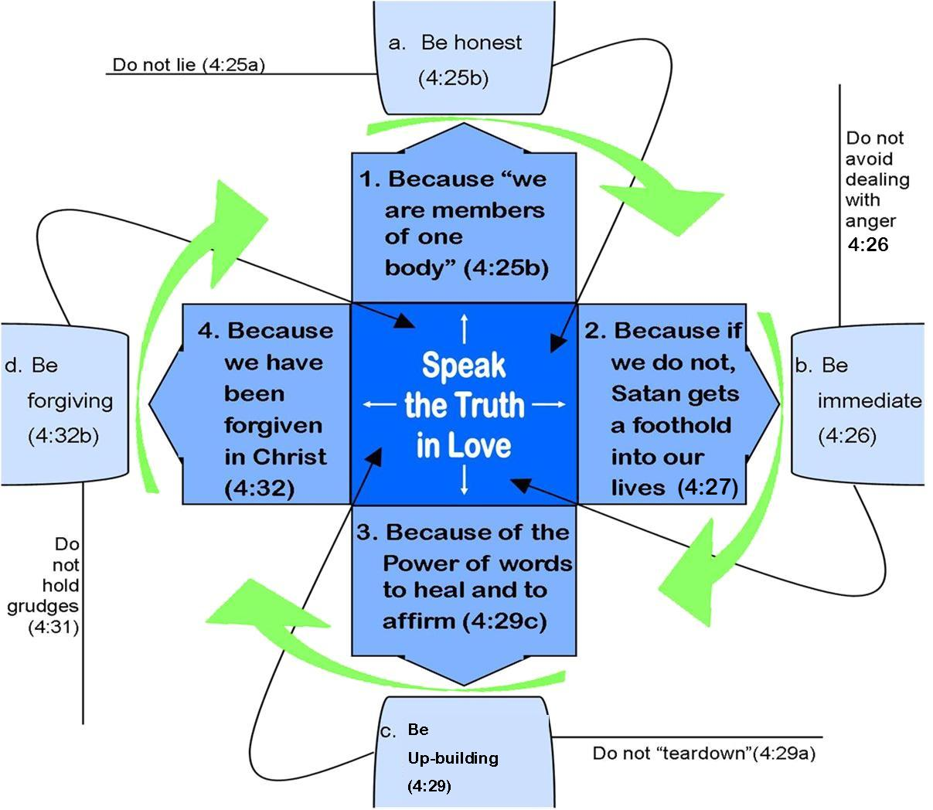

Slide 28
Conclusion
The Spirit of God is deeply concerned with the speech of his people. (Ephesians 4:30a)
The spiritual life of the leader is the key to maintaining the “unity of the Spirit” in the midst of the multifaceted diversity within a Christian community.

Slide 29
Tuesday
Afternoon
Goal of
Leadership

Slide 30
Leadership for
Congregational Transformation
Leadership for congregational transformation involves the equipping of the people of God for ministry and mission. The assignment of transformational leadership is to define, clarify, and prepare each disciple
for her or his God-called ministry.

Slide 31
The nature of transformational leadership is outlined in Ephesians 4:11-16.
The context of congregational transformation is “God’s People” or “ministry participation.” (Ephesians 4:11).
The task in congregational transformation is to “prepare God’s people” or “ministry formation.” (Ephesians 4:12)

Slide 32
The nature of transformational leadership is outlined in Ephesians 4:11-16.
The goal of congregational transformation is “works of service” or “ministry expression.” (Ephesians 4:12).
The dynamic of congregational transformation is “love within the body of Christ” or “ministry interaction.” (Ephesians 4:15-16).
The purpose of congregational transformation is a “holiness lifestyle” or Christ-like ministry.” (Ephesians 4:13).

Slide 33
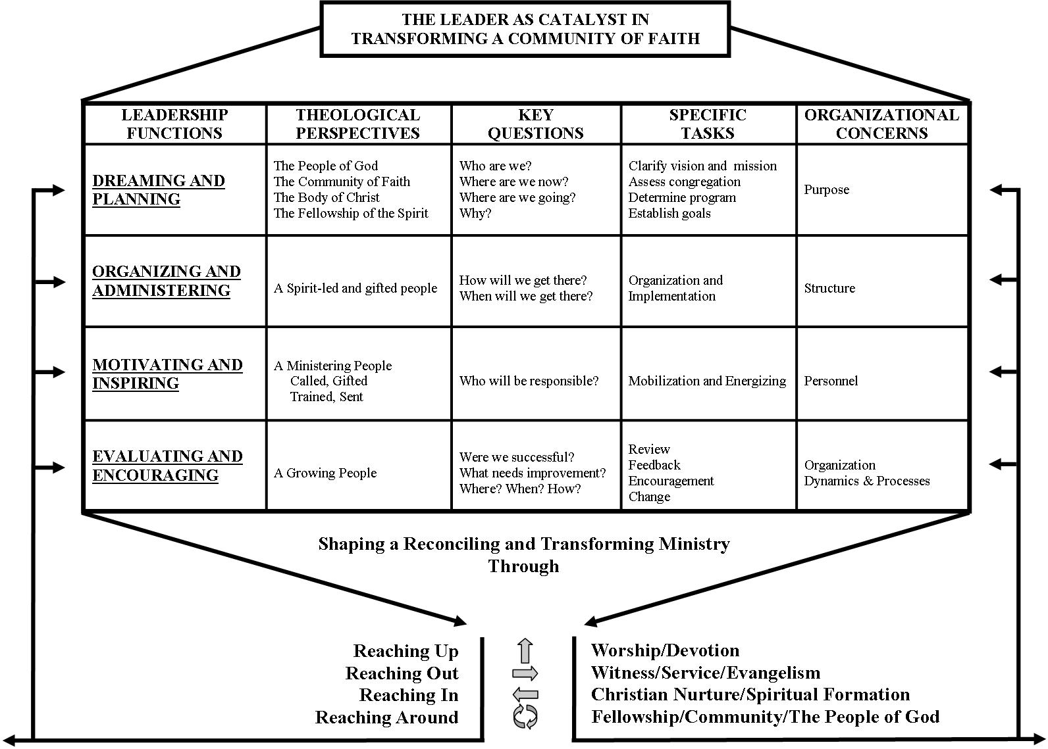

Slide 34
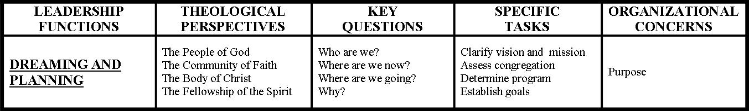
THE LEADER AS CATALYST IN
TRANSFORMING A COMMUNITY OF FAITH
Dreaming and Planning

Slide 35
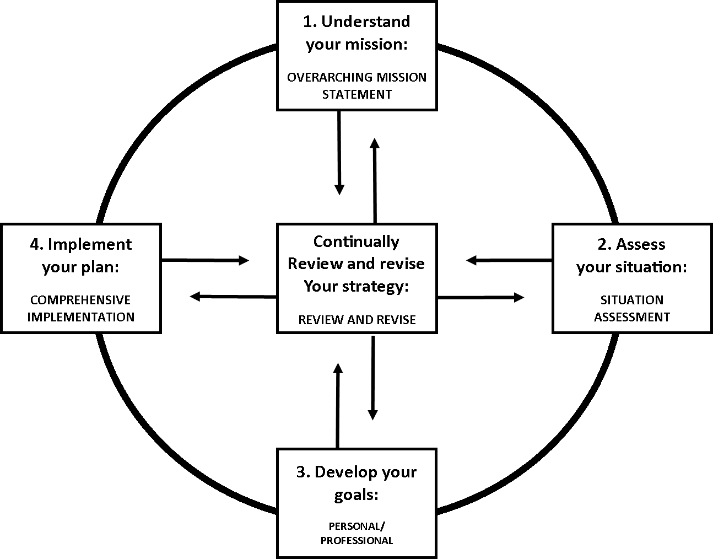
Planning
Cycle

Slide 36

Planning
Cycle
1. Understand
your mission:
OVERARCHING MISSION STATEMENT

Slide 37
Personal Mission Statement
“My mission is to be a Christian role model and leader to my family first, and subsequently to the Mount Vernon Nazarene College community in the context of servant and visionary leadership.
I will give attention to the financial needs of my family, including retirement, and keep myself physically and emotionally conditioned to enable me to function with maximum effectiveness.
I am a growing professional who gives priority time to strategic planning for the institution I serve. In this context, I will enable and energize my family, friends, and colleagues to give their best to their unique roles and assignments.
All of my activities initiate from and operate out of a pastoral calling as one who views himself first and foremost as a follower of Jesus who articulates, models, and is committed to His life and teachings.”

Slide 38
Personal Mission Statement (cont.)
On August 1, 2009, I revised the above personal mission statement to reflect a new phase of ministry to which I had been called following my retirement form MVNU:
“I want my ‘senior’ years to be characterized by personal growth, professional development, maturing faith, mentoring leaders, nurturing family, cultivating friendships, compassion for the poor, and passing on to a new generation of Christian leaders, particularly through writing, what has been so freely passed on to me.”

Slide 39
Planning
Cycle
1. Understand
your mission:
OVERARCHING MISSION STATEMENT
Continually
review and revise
your strategy:
REVIEW AND REVISE

Slide 40
Planning
Cycle
1. Understand
Your mission:
OVERARCHING MISSION STATEMENT
Continually
review and revise
your strategy:
REVIEW AND REVISE
2. Assess your situation:
SITUATION
ASSESSMENT

Slide 41
CONSTITUENCY ASSESSMENT
(CONGREGATIONAL ANALYSIS,
SITUATION ANALYSIS, GROUP NEEDS ASSESSMENT)
“UNDERSTANDING WHERE
YOU AND YOUR PEOPLE ARE NOW
AS THE REALISTIC STARTING POINT
FROM WHICH YOU MOVE TO
WHERE YOU WANT TO GO,
WHY YOU NEED TO MOVE.”

Slide 42
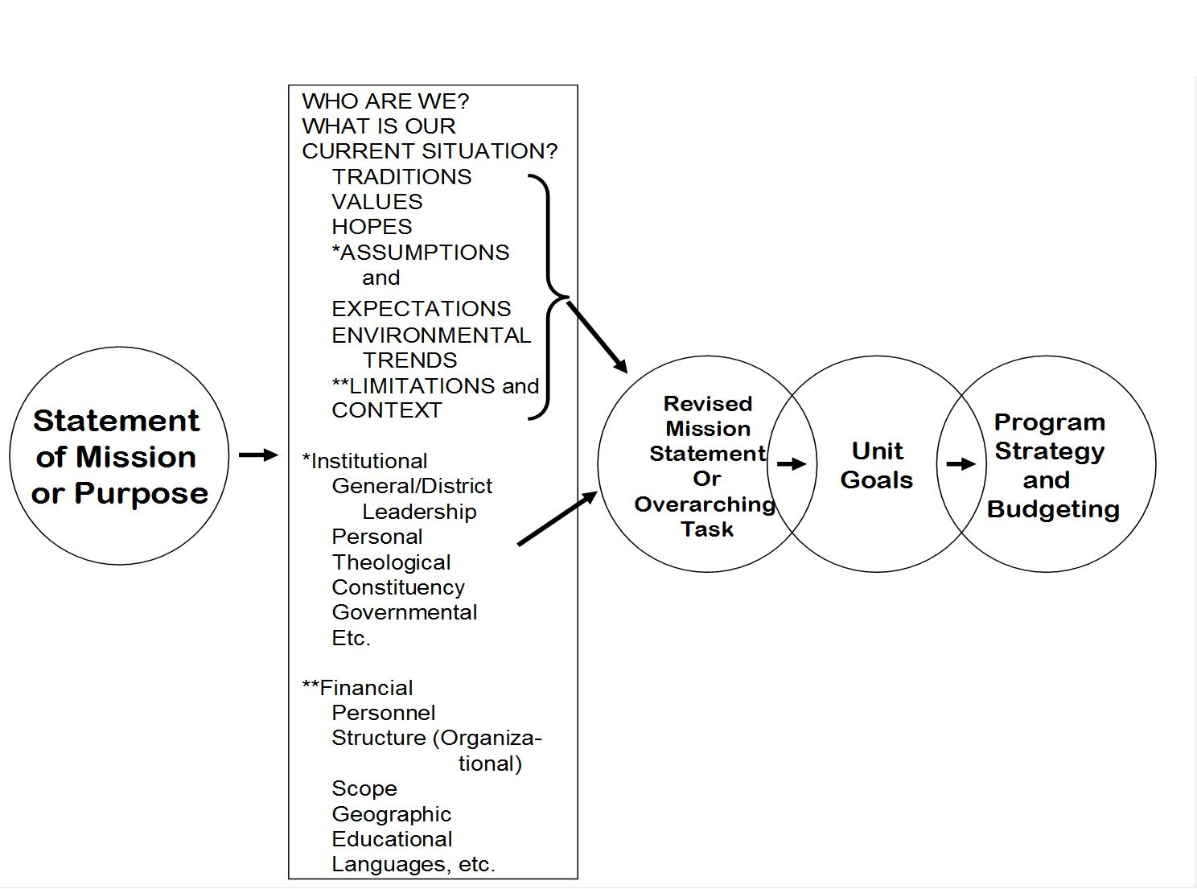
Flow of
Institutional/organizational
Planning Process

Slide 43
Planning
Cycle
1. Understand
Your mission:
OVERARCHING MISSION STATEMENT
Continually
review and revise
your strategy:
REVIEW AND REVISE
2. Assess your situation:
SITUATION
ASSESSMENT
3. Develop your goals:
PERSONAL/
PROFESSIONAL

Slide 44
ESTABLISH GROWTH GOALS
Growth goals are statements of faith for the Christian leader that express clearly what we believe God will do through us.
A GOAL should be:
1. Be measurable.
2. Be feasible
3. Be attainable.
4. Contain an action verb.
5. Have a deadline.

Slide 45
Planning
Cycle
1. Understand
Your mission:
OVERARCHING MISSION STATEMENT
4. Implement your plan:
COMPREHENSIVE
IMPLEMENTATION
Continually
review and revise
your strategy:
REVIEW AND REVISE
2. Assess your situation:
SITUATION
ASSESSMENT
3. Develop your goals:
PERSONAL/
PROFESSIONAL

Slide 46
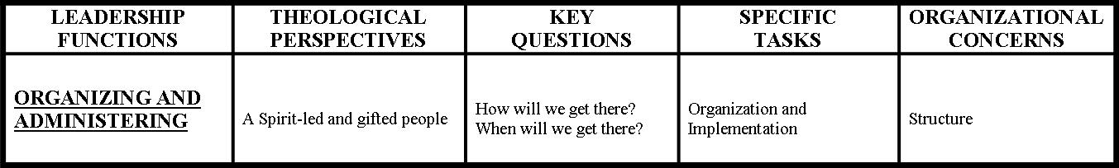
THE LEADER AS CATALYST IN
TRANSFORMING A COMMUNITY OF FAITH
Organizing and Administering

Slide 47
Christian leaders, by God’s grace, plan for things to
happen. And, they organize accordingly. These leaders:
Are deciders rather than drifters.
Know where they are going, and how they are going to get there.
Are results-oriented and not just activity-oriented.
Are among the 3% who write down their growth goals.
Pursue goal setting in the context of a broader planning strategy.
Develop a mission statement.
Dream great dreams.
Understand leadership is the transference of vision.
Are constantly involved in an ongoing analysis of their constituents.
Establish growth goals.
Are mission driven.
Work hard at detailing programs and plans.
Continually reviews and revises the planning strategy for growth.
Expect great things from God and attempt great things for God.

Slide 48
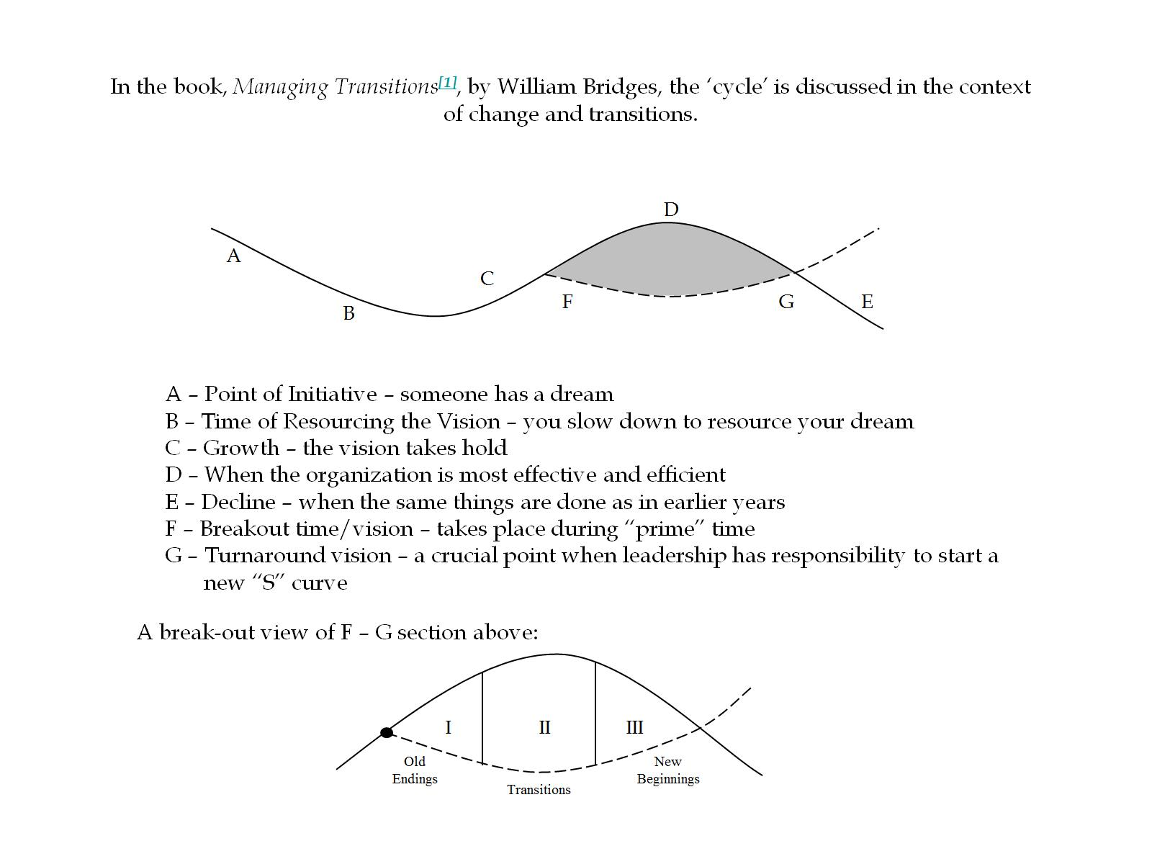

Slide 49
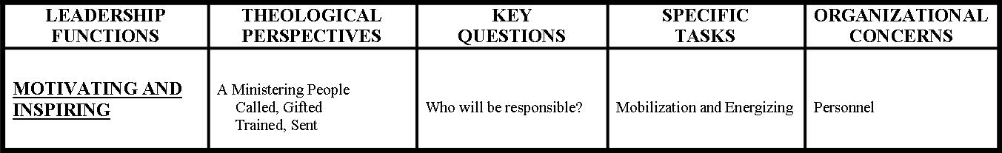
THE LEADER AS CATALYST IN
TRANSFORMING A COMMUNITY OF FAITH
Motivating and Inspiring

Slide 50
Encouraging the Heart
The First Essential: Set clear Standards
The Second Essential: Expect the Best
The Third Essential: Pay Attention
The Fourth Essential: Personalize Recognition
The Fifth Essential: Tell the Story
The Sixth Essential: Celebrate Together
The Seventh Essential: Set the Example
James Kouzes and Barry Posner

Slide 51
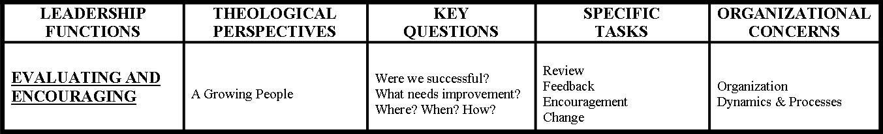
THE LEADER AS CATALYST IN
TRANSFORMING A COMMUNITY OF FAITH
Evaluating and Encouraging

Slide 52
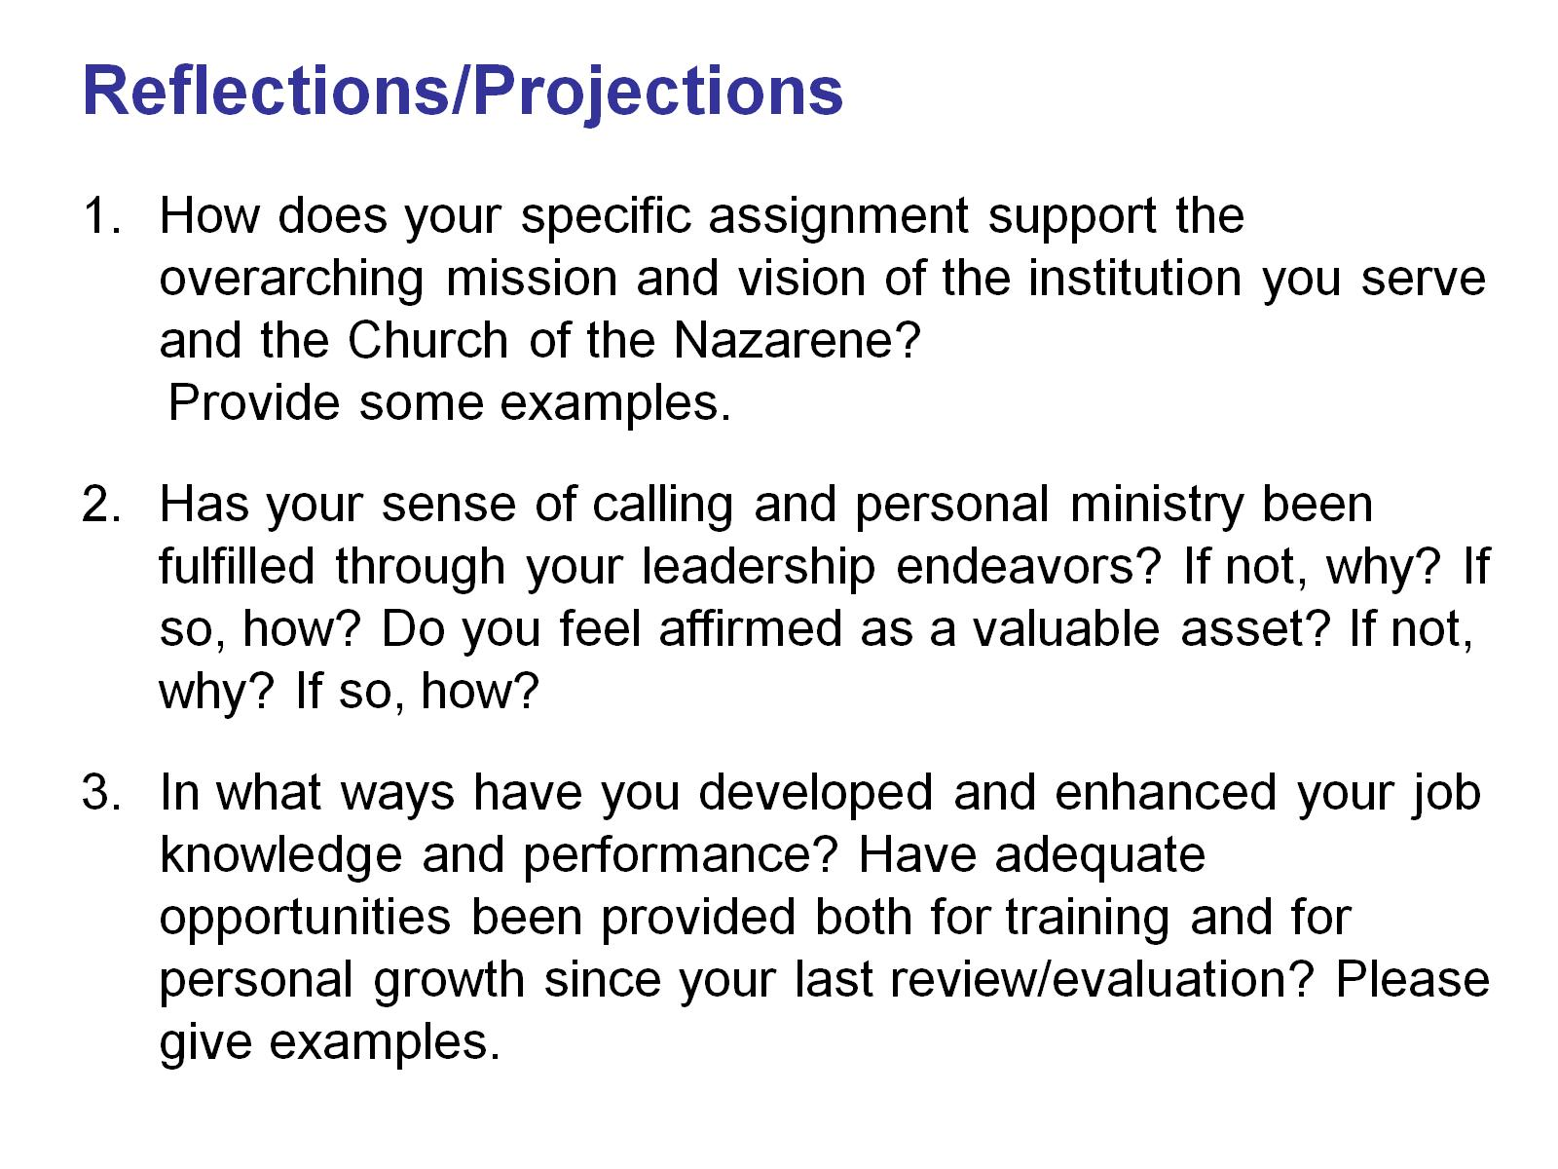

Slide 53
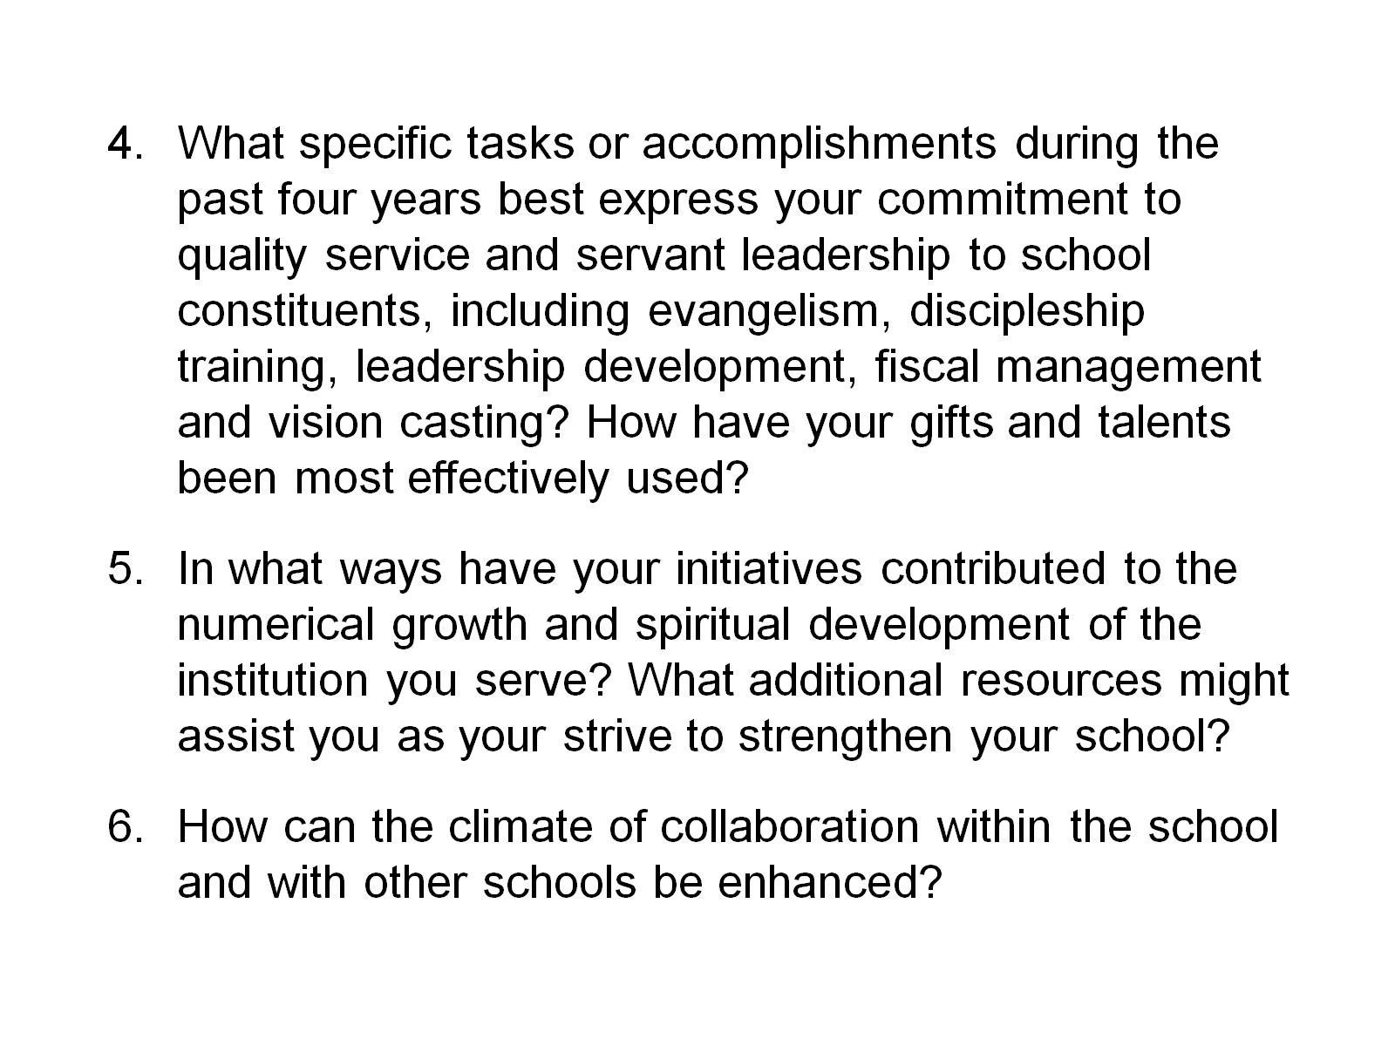

Slide 54
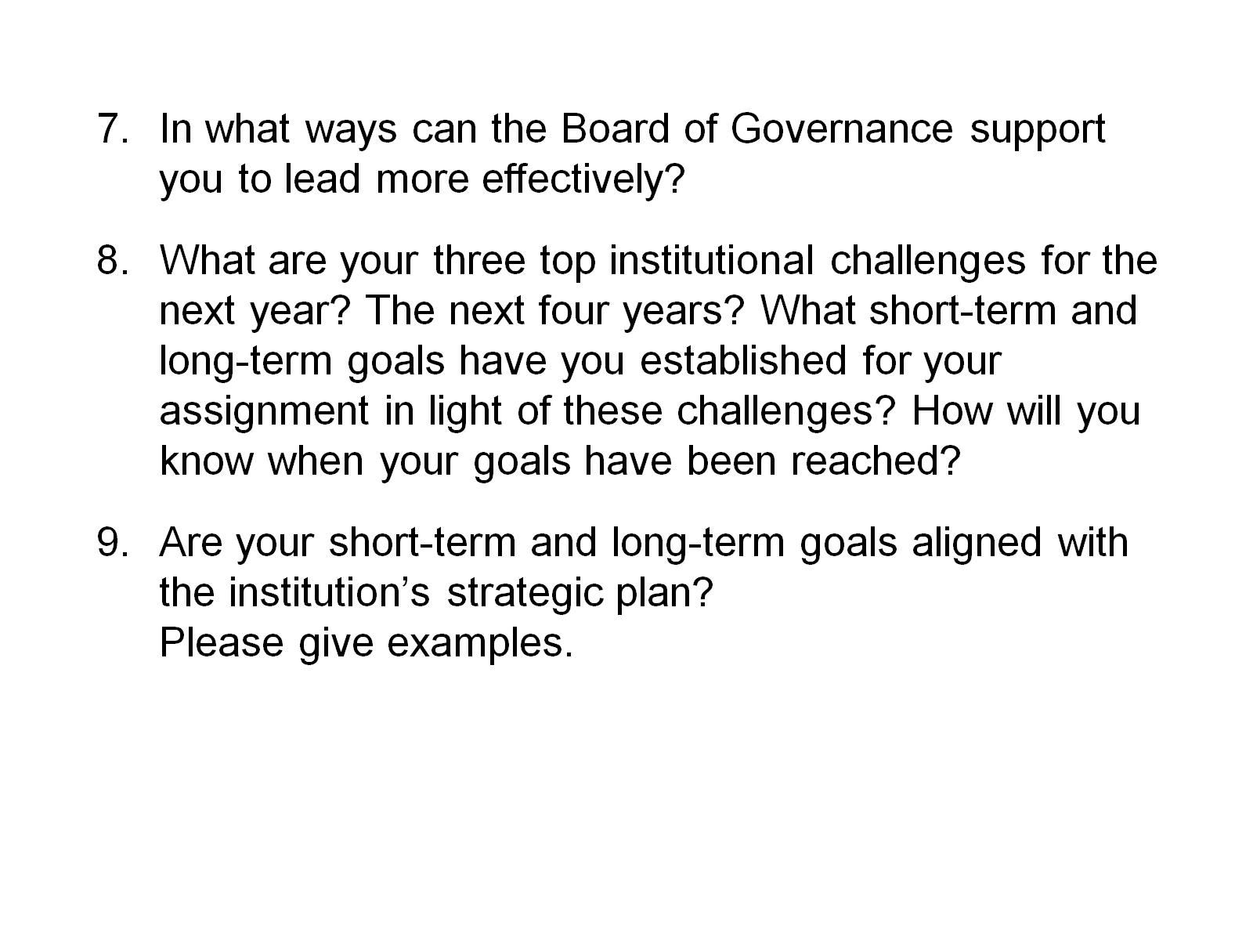

Slide 56
Wednesday
Morning
Method of
Leadership

Slide 57
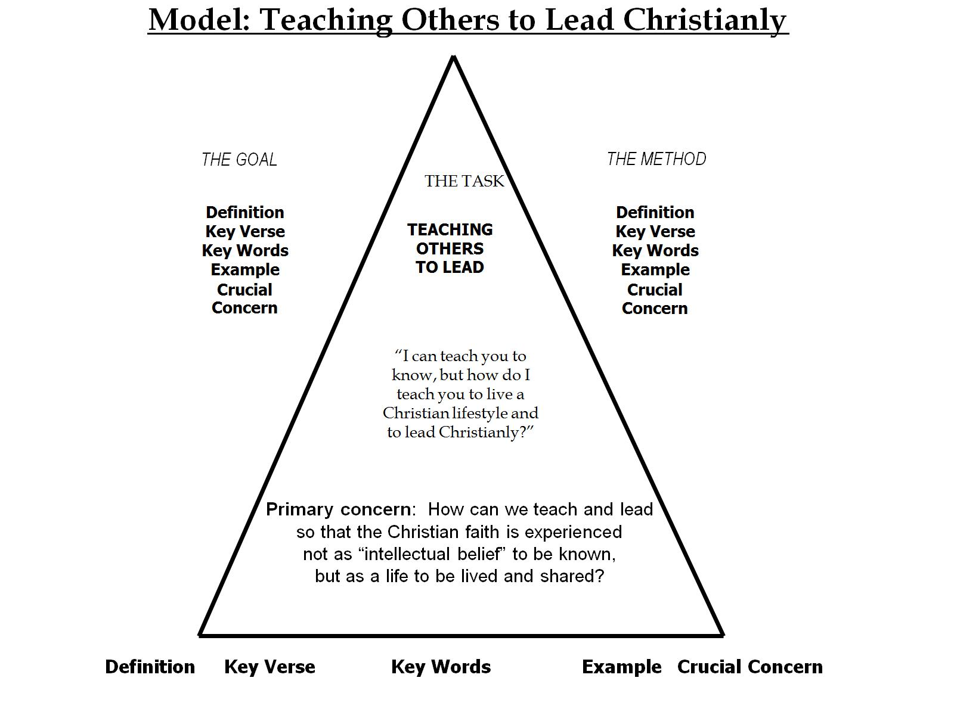

Slide 58
Basic Mentoring Questions
What are your priorities?
How Can I help?

Slide 59
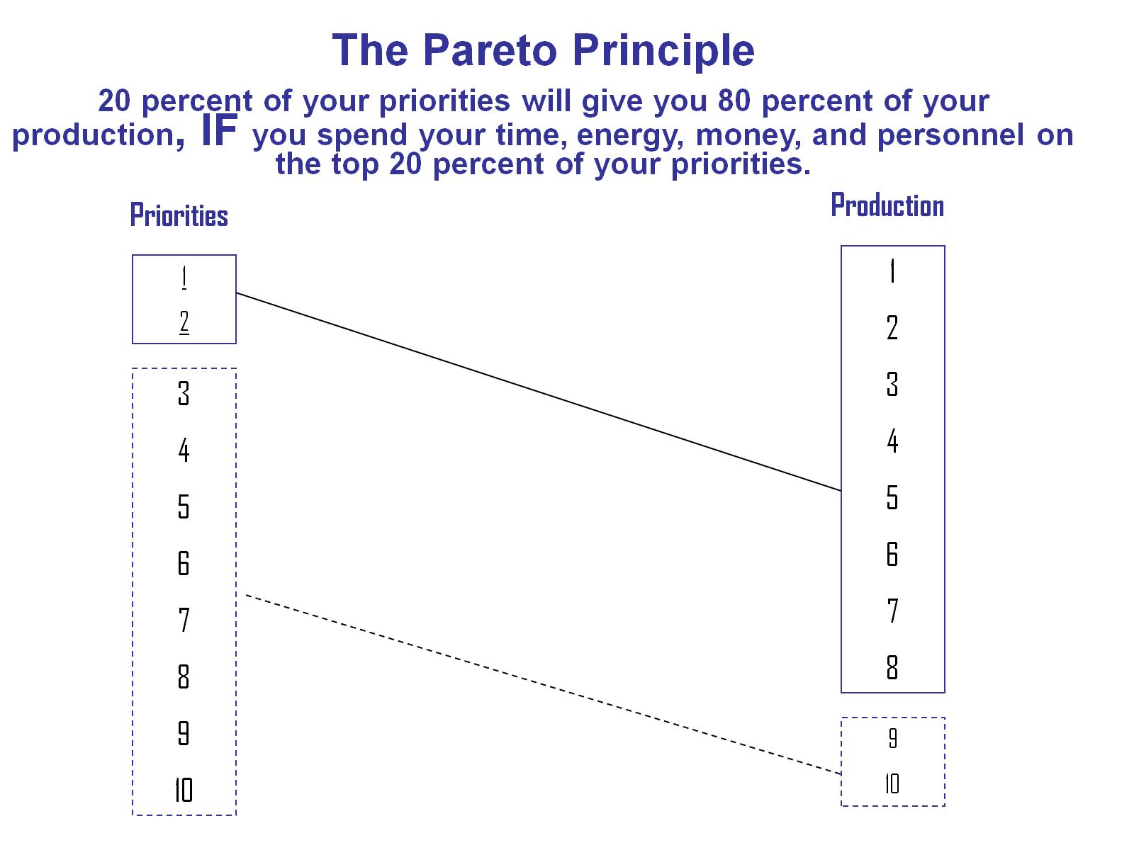

Slide 60
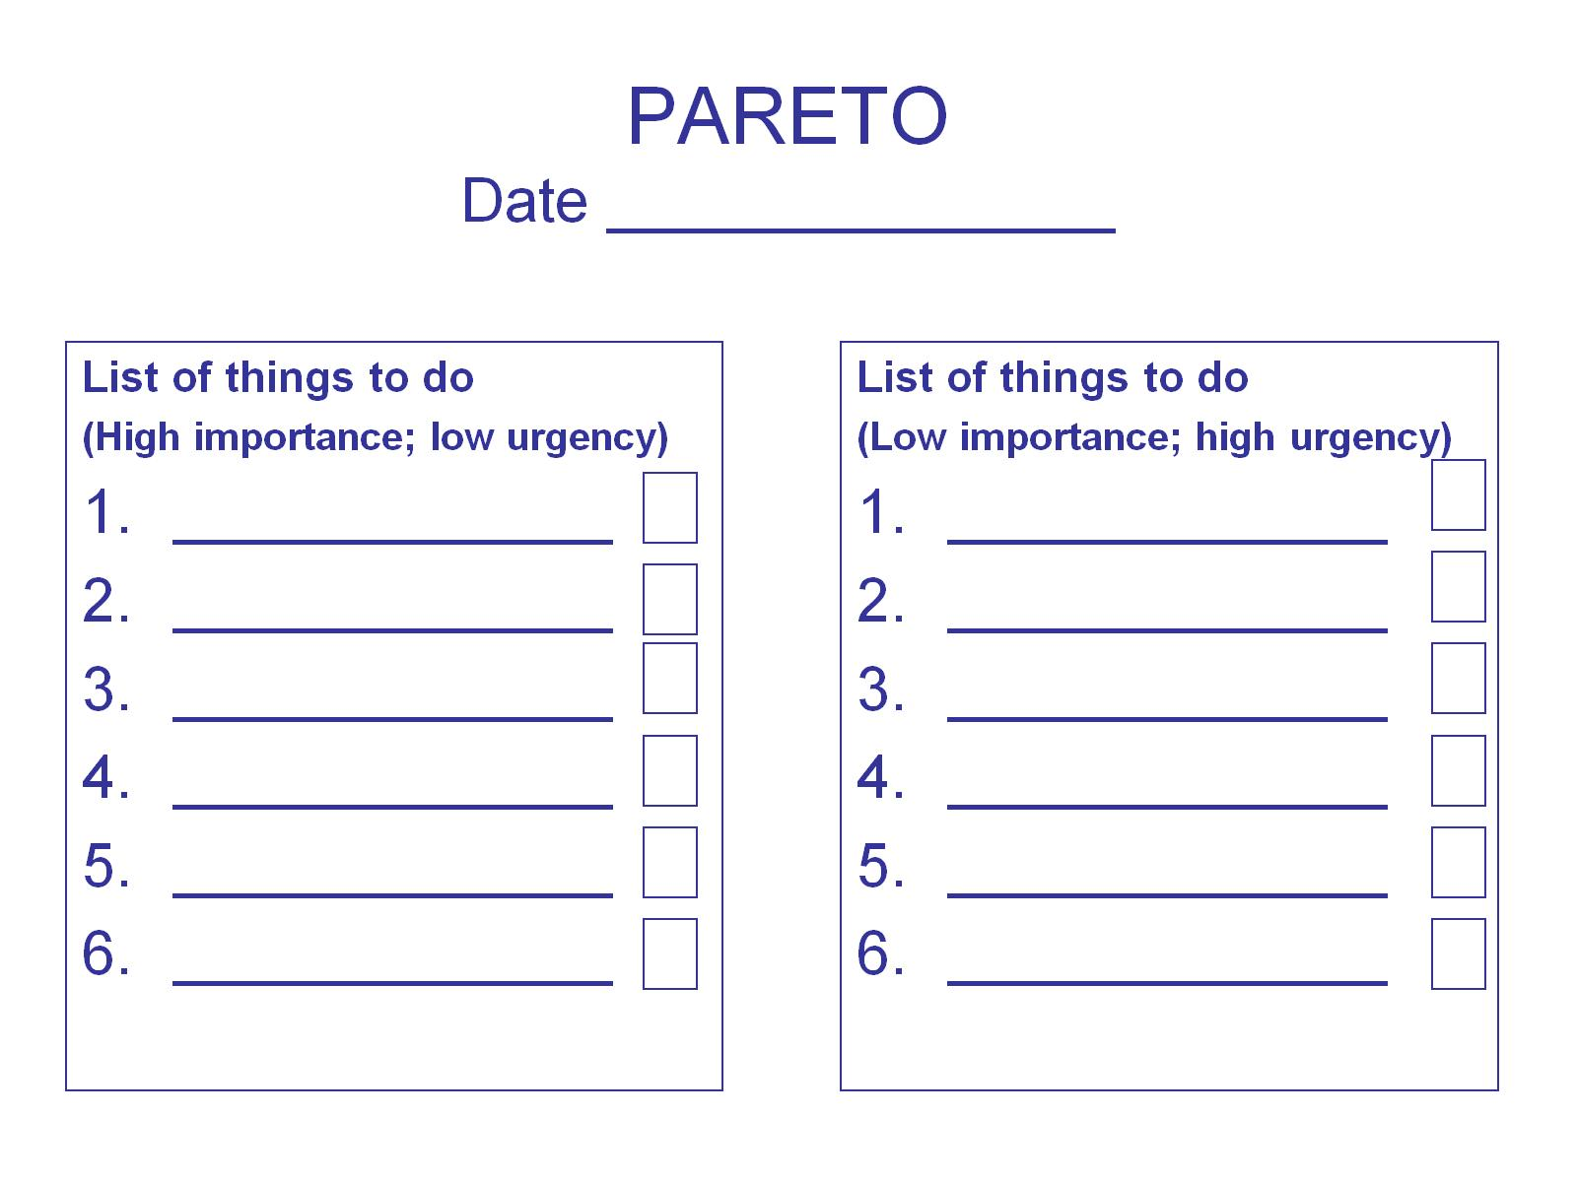
PARETO
Date _______________

Slide 61
Characteristics and
Best Practices of
Strong and Effective
Governing Boards

Slide 62
Characteristic #1
Board members
understand the role,
purpose and function
of the board,
including board structure

Slide 63

NOSE IN –
FINGERS OUT
Best Practice:

Slide 64
Effective Governing Boards …
focus on policy formation
and mission strategy;
not policy implementation
and daily operations.

Slide 65
1a. Three modes of university governance.
Fiduciary mode:
Strategic mode
Representative mode
Guard the agenda!

Slide 66
Characteristic #2
Board members
know, communicate, and
make decisions
in light of the university’s
mission, vision and values.

Slide 67
Mission and values drive us
Best Practice:

Slide 68
Realizing Our Intentions
“Always, the key question to be asked in Board decision making is:
Is this decision important for the long term survival, health, and mission achievement of our institution?
After answering this question, then policies and decisions can be made.”
Albert J. Meyer, author. p. 217

Slide 69
Characteristic #3
Board members
ask the
right questions

Slide 70
Think questions
Best Practice:

Slide 71

Board Members Ask The Right Questions (value defining and forward thinking…)
Who are we?
Where are we?
Where are we going?
How will we get there?
Why is it important to get there?
How will we know when we get there?

Slide 72
Characteristic #4
Board members
understand and embrace
a Board Policy Manual
that contains
the Board approved policies for effective and efficient governance of organization.

Slide 73
Write it down
Best Practice:

Slide 74
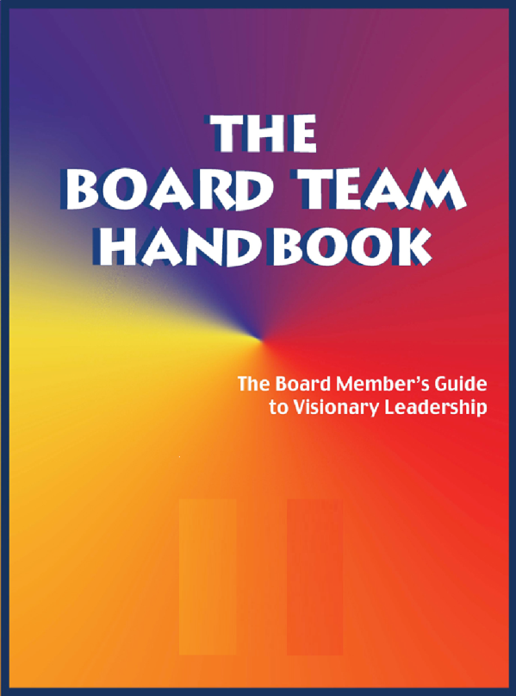
Board members understand and embrace a Board Policy Manual
that contains
the Board approved policies
for effective and efficient governance of the
university.

Slide 75
Characteristic #5
Board members
communicate
with each other and
address conflict situations
as Christians.

Slide 76
Watch your words
Best Practice:

Slide 77


Board members communicate
with each other Christianly (Eph. 4:2), compassionately,
respectfully,
directly,
and supportively.

Slide 78

Vigorously discuss policy options and make decisions within the board meetings,
And communicate board action outside the board
meetings with
unified support.

Slide 79
Characteristic #6
Board members
listen to the constituency, appreciate the heritage
of the school,
and model
faith development and spiritual formation.

Slide 80

Active representatives of the university
Best Practice:

Slide 81
Character Counts
Speak Gracefully.
Live Gratefully.
Listen Intently.
Forgive Freely.
Lead Decisively.
Care Deeply.
Pray Earnestly.

Slide 82
Characteristic #7
Board members
intentionally engage
in mutual accountability,
including systematic
board development
and evaluation.

Slide 83
Integrity matters
Best Practice:

Slide 84
Board Development Questions:
How does work of the board support the overarching mission and vision of the university?
In what ways have the initiatives of the board contributed to the numerical growth and spiritual development of the university?
How can the climate of collaboration between the board, council, senate and school leaders be enhanced?
What are the three top institutional challenges for the next year? What short-term and long-term goals have been established in light of these challenges?
Are the board’s short-term and long-term goals aligned with the institution’s strategic plan?

Slide 85
Characteristic #8
Board members
take time to
process decisions and
adhere to the practice of
“no surprises”

Slide 86
Take
Time
Best Practice:

Slide 87
The Board leadership and school leadership work together to plan, set agendas, and develop policy recommendations to the Board.
The school leader is involved in any board development process, and the board chair is kept abreast of major developments in the university.

Slide 88
Characteristic #9
Board members
embrace change and resolve
to work through transitions
together and united for
the good of the Kingdom and the advancement of God’s mission.

Slide 89
Yes! To vision-inspired change
Best Practice:

Slide 90
Characteristic #10
Board members
participate in assessing
the effectiveness
of prior decisions
and collectively
make appropriate adjustments.

Slide 91
Review – Revise – restate – renew
Best Practice:

Slide 92
Planning
Cycle
1. Understand
Your mission:
OVERARCHING MISSION STATEMENT
4. Implement your plan:
COMPREHENSIVE
IMPLEMENTATION
Continually
review and revise
your strategy:
REVIEW AND REVISE
2. Assess your situation:
SITUATION
ASSESSMENT
3. Develop your goals:
PERSONAL/
PROFESSIONAL

Slide 93
Characteristic #11
Board members
are outstanding examples
of giving regularly
and sacrificially
to the church
and the university.

Slide 94
Role models of generosity
Best Practice:

Slide 95

Financial donors look first
to board members for evidence
of their consistent giving
to the university
-individually and collectively

Slide 96
Characteristic #12
Board members
develop new leaders
for increased responsibilities
and commitment
to the organization.

Slide 97
Pass it on
Best Practice:

Slide 98

Reproduce yourself
as a passionate advocate
for the university.

Slide 99
Use committees as a way to provide opportunities for emerging leaders to take on more responsibility.
Board leaders should intentionally mentor and nurture the next generation of board leadership!

Slide 100
In Summary…
Processes to be clarified?
Policies needed?
Questions to be asked?
Plans to be developed?
Projects to be initiated?
Recommendations to the board chair?
Next steps?

Slide 101
Best Practices embraced:
NOSE IN – FINGERS OUT
MISSION AND VALUES DRIVE US
THINK QUESTIONS
WRITE IT DOWN
WATCH YOUR WORDS
ACTIVE REPRESENTATIVES OF THE UNIVERSITY
INTEGRITY MATTERS
TAKE TIME
YES! TO VISION-INSPIRED CHANGE
REVIEW-REVISE-RESTATE-RENEW
ROLE MODELS OF GENEROSITY
PASS IT ON

Slide 102
Wednesday
Afternoon
Pain & Vision of
Leadership

Slide 103

Vision

Slide 104
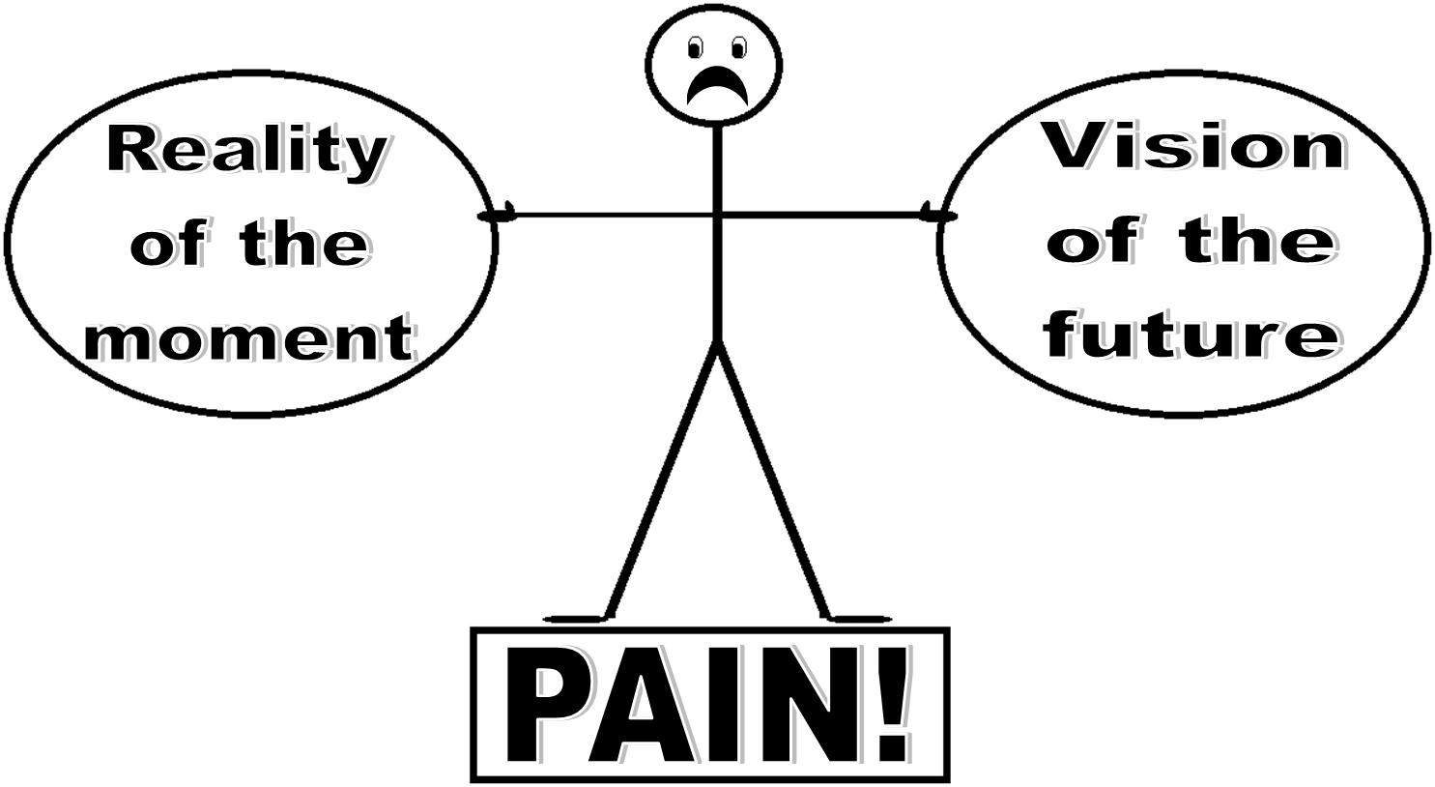

Slide 105

Reality
Vision

Slide 106
Vision
Reality

Slide 107
Good and godly people often differ on how to reach mutually desired goals . . .

Slide 108
Is it possible . . . to live and work together as Christians so that our relationships are redemptive and a witness to unbelievers?

Slide 109
If “in Christ, all things are made new,” then how does our relationship with Christ inform and guide us in the way we lead?

Slide 110
In the midst of these conflicting situations . . . What does it mean, really mean, to lead . . . With the mind of Christ?

Slide 111
Seven “anchors” that hold us steady as Christian leaders . . .

Slide 112
Anchor #1:
“Speak Gracefully”

Slide 113
Our words
can be channels
of God’s grace to others
Ephesians 4:29

Slide 114
Encourage or discourage
Uplift or “putdown”
Speak positively or negatively
Reflect cultural sensitivity or cultural “blindness”
Focus on the other person, or focus on self

Slide 115
How do others feel when they leave our presence?
Stronger or weaker?
Larger of smaller about themselves?
Confident or hesitant?
Understood or misunderstood?
Affirmed or manipulate?
Blessed or “destroyed”?

Slide 116
“The praise to criticism ratio”
80 / 20

Slide 117
Remember Anchor #1:
“Speak Gracefully”

Slide 118
Anchor #2:
“Live Gratefully”

Slide 119
Give thanks in all circumstances,
for this is God's will
for you in Christ Jesus.
I Thessalonians 5:18

Slide 120
We can feel good about ourselves . . . until we compare ourselves with the gifts, talents, and abilities of other people.

Slide 121
What is the antidote to comparison?
Gratitude!
Gratitude!
Gratitude!

Slide 122
Remember Anchors #1 & #2:
“Speak Gracefully”
“Live Gratefully”

Slide 123
Anchor #3:
“Listen Intently”
Listen for more than words . . .

Slide 124
Good and godly people sometimes collide over vision and values.

Slide 125
Theological vision
must precede
organizational vision.

Slide 126
Growth producing questions:
“What can I learn? How can I change?”
Growth inhibiting questions:
“Why me? What if …?”

Slide 127


These two ways of
thinking and reacting
can be diagrammed as follows:
Growth Producing
Growth Inhibiting

Slide 128
Remember Anchors #1 & #2 & #3:
“Speak Gracefully”
“Live Gratefully”
“Listen Intently”

Slide 129
Anchor #4:
“Forgive Freely”

Slide 130
Jesus said,
"Father, forgive them,
for they do not know
what they are doing."
Luke 23:34

Slide 131
Remember the first four Anchors:
“Speak Gracefully”
“Live Gratefully”
“Listen Intently”
“Forgive Freely”

Slide 132
Anchor #5:
“Lead Decisively”

Slide 133
It is in the tension between our vision for the future and reality of the present that our decision-making as leaders most often
takes place!

Slide 134
We move ahead
decisively through
Prayer . . .
Collaboration . . .
Gratitude . . .

Slide 135
In this spirit
of humility and brokenness,
we move ahead.

Slide 136
To lead decisively with Christian humility demands these skills:
Listening and communicating;
Timing and processing;
Affirming and encouraging;
Asking and inquiring; and
Discernment and delegation.

Slide 137
Remember these 5 Anchors:
“Speak Gracefully”
“Live Gratefully”
“Listen Intently”
“Forgive Freely”
“Lead Decisively”

Slide 138
Anchor #6:
“Care Deeply”

Slide 139
Caring Christians
value people,
not power.

Slide 140
The final Anchor is this:
“Pray Earnestly”

Slide 141
Pray, believing
that God can work
in me
to become the change
  I desire to see in others.

Slide 142
Focus on the things
that unite us,
not divide us.

Slide 143
I try to enlarge the vision of my people about their work. I want them to see the big picture of the school.

Slide 144
I really want . . .
my words to be grace-giving, life-generating and inspiring to others;
to be known as a person who is forever grateful;
to listen to and respect the people with whom I work, to understand them;

Slide 145
to initiate forgiveness when I have been offended;
to lead decisively with humility even when there are differences of opinion;
my relationship with others to energize and strengthen them in their faith and work.

Slide 146
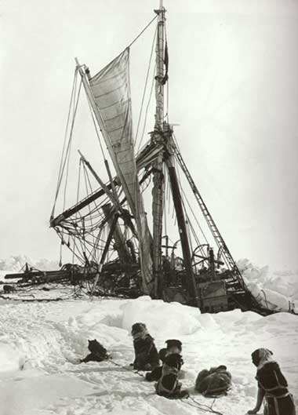
Ernest Shackleton
1914
Imperial
Trans-Antarctic
Expedition
(LINK)

Slide 147
Thursday
Morning
Evidence of
Leadership

Slide 148
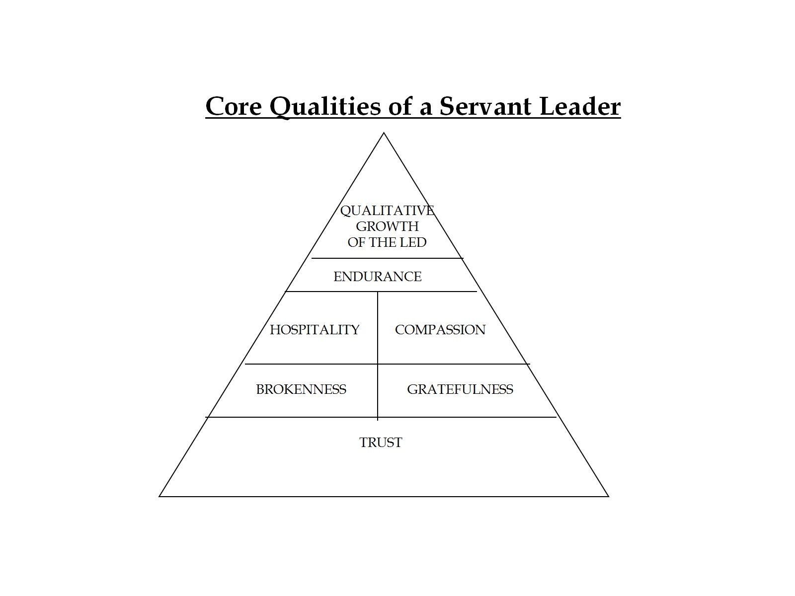

Slide 149
“The concept of hospitality is one of the richest concepts to deepen our insights in the relationship with our fellow human beings.”
“The concept of hospitality may offer a new dimension to our understanding of the healing relationship and the formation of a recreating community.”
Henri Nouwen

Slide 150
“Hospitality is not a subtle invitation to adopt the lifestyle of the host,
but the gift of a chance to allow
the guest to find his/her own . . . Hospitality wants to offer friendship without binding the guest; and freedom without leaving him alone.”
Henri Nouwen

Slide 151
“Preaching, teaching, counseling, organizing and celebrating – they are all forms of ministry by which we create space for the stranger,
space where he can enter into deeper contact with himself,
his fellowman, and his God.”
Henri Nouwen

Slide 152
“When I use the term hospitality, therefore, I do not want to limit it to the liberal sense of receiving a stranger into your house . . . It is a fundamental attitude toward our fellow human beings, which can be expressed by a great variety of behavior.”
Henri Nouwen

Slide 153
“Hospitality means primarily
the creation of a space where
the stranger can enter
and become a friend instead of an enemy . . . It is not an attempt to change people, but to offer
the free space where
change can take place.”
Henri Nouwen

Slide 154
Key Attitudes
Attitude of the heart (Ephesians 4:23) that should increasingly characterize spirit-filled Christians include the following:
I love you – you are my brother/sister in Christ.
I need you – you are being changed by Christ as I am being changed.

Slide 155
Key Attitudes
I respect you – you are different, yet we are one in Christ.
I trust you – you desire to serve the same Christ as I.
I serve you – I want to minister grace to you.

Slide 156
Key Habits
Steven Covey
BE PROACTIVE: The Habit of Responsibility.
BEGIN WITH THE END IN MIND: The Habit of Leadership.
PUT FIRST THINGS FIRST: The Habit of Management.

Slide 157
THINK WIN-WIN: The Habit of Mutual Benefit.
SEEK FIRST TO UNDERSTAND, THEN TO BE UNDERSTOOD: The Habit of Communication.
SYNERGIZE: The Habit of Interdependence.
SHARPEN THE SAW: The Habit of Continuous Improvement.

Slide 158
Key Values
A Magnanimous spirit
A servant mentality
A trustworthy character
A positive influence
A courteous response
A giving motivation
A grateful attitude

Slide 159
PERSONAL CREED
Prime Personal and Professional Principles
Succeed at home first.
Seek and merit Divine help.
Never compromise with honesty.
Remember the people involved.
Hear both sides before judging.

Slide 160
PERSONAL CREED
Prime Personal and Professional Principles
Plan tomorrow today.
Develop one new proficiency a year.
Attain visibility by productivity.
Hustle while you wait.
Facilitate the success of your colleagues.

Slide 161
Key Personal Goals…
Find ways to
honor their time.
value their work.
build their confidence.
increase their competence.
support their decisions.

Slide 162
Key Personal Goals (cont.)
Find ways to
hear their words.
network their ideas.
affirm their dreams.
simplify their assignment.
strengthen their faith.

Slide 163
“Communication is the greatest single factor affecting
one’s personal health
and his relationship
to God and to others.”
Adapted from Virginia Satir, Peoplemaking

Slide 164
“To be able to apologize without placating,
to disagree without blaming, to be reasonable without being inhuman and boring, to be able to change the subject without distracting gives me greater personal satisfaction, less internal pain, and more opportunities for growth and more satisfactory relationships with others, to say nothing about increase competence.”
Virginia Satir, Peoplemaking

Slide 165
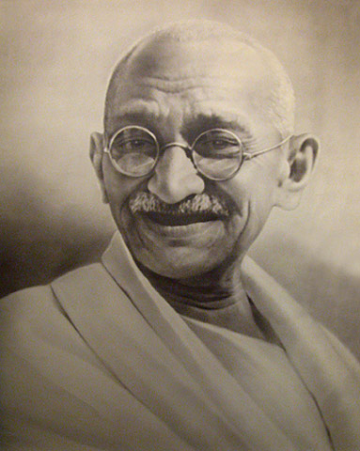
Gandhi
(LINK)

Slide 166
Friday
Morning
To
Review

Slide 167
Course Themes
The MOTIVATION of servant leadership is grounded in a theology of church and ministry.
The LIFESTYLE of servant leadership is characterized by a passion for Christlikeness.
The GOAL of servant leadership is reconciliation, transformation, and disciple-making, individually and collectively.
The METHOD of servant leadership is example, visioning, “strengths-development,” and teaching.
The PAIN of servant leadership is experienced in the tension when good and Godly people collide.
The EVIDENCE of servant leadership is in the qualitative growth of the led.

Slide 168
The Servant Song
Brother, let me be your servant.
Let me be as Christ to you;
Pray that I may have the grace to
Let you be my servant too.
We are pilgrims on a journey;
We are brothers on the road.
We are here to help each other
Walk the mile and bear the load.
I will hold the Christ-light for you
In the night-time of your fear;
I will hold my hand out to you,
Speak the peace you long to hear.

Slide 169
I will weep when you are weeping;
When you laugh, I’ll laugh with you.
I will share your joy and sorrow
Till we’ve seen this journey thro’.
When we sing to God in heaven,
We shall find such harmony.
Born of all we’ve known together
Of Christ’s love and agony.
Sister, let me be your servant.
Let me be as Christ to you;
Pray that I may have the grace to
Let you be my servant too.

Slide 170
Prepared for BoardServe LLC
Edward LeBron Fairbanks, founding director
BoardServe.org
lfairbanks@boardserve.org
Facebook.com/BoardServe
Presented at Nazarene Theological College,
Brisbane, Australia
May 20-22, 2013

Slide 171
All rights reserved
Please request permission to use this material

